Slide 1


Slide 2

Visual Basic .NET is the next generation of Visual Basic
VB.NET is a programming language designed to create applications that work with Microsoft's new .NET Framework.
VB .NET offers a number of new features and advantages over Visual Basic. One of them being VB.NET is an object-oriented programming language

Slide 3

The framework defines the environment that you use for executing VB.NET applications and services you can use within these application
The goal of VB .NET is to address the limitations of Visual Basic as a development environment and bring it into the Internet age so that it can remain the major platform for developing applications of all kinds.
Thus, VB.NET and Visual Studio.NET aims at providing a graphical interface that is suitable for developing web applications and for taking full advantage of the Internet as an application-development platform, as well as for developing Windows applications and components

Slide 4

.NET Framework Class Library provides pre-written code in the form of classes that are available to all the .NET programming languages
Common Language Runtime(CLR) is the module that actually runs your VB.NET applications. It also performs memory management and garbage collection. They also include a unified system of exception handling, which makes it possible to use the same set of debugging tools on all code, regardless of the particular .NET language in which it was written.

Slide 5

It is the product used to develop applications in VB.NET
Programming languages supported are VB.NET, Visual C# NET, Visual C++ NET
Components of Visual Studio.NET
  Microsoft Development Environment(MDE)
  Microsoft SQL Server 2000 Desktop Engine(MSDE)

Slide 6

Microsoft Visual Studio’s MDE is the main Integrated Development Environment (IDE) from Microsoft. It can be used to develop console and Graphical user interface applications along with Windows Forms applications, web sites, web applications, and web services
MSDE is a database engine that runs in your PC and through Visual Studio develop database applications compatible with Microsoft SQL Server, which in turn is a RDBMS.

Slide 7

The IDE main menu provides the following commands, which lead to submenus. Most of the menus can also be displayed as toolbars.
File Menu Data Menu
Edit Menu Format Menu
View Menu Tools Menu
Project Menu Window Menu
Build Menu Help Menu
Debug Menu
The Toolbox Window
The Solution Explorer
The Properties Window
The Output Window
The Command Window
The Task List Window

Slide 8
The Toolbox Window: It includes all the controls that we need to build our application’s interface.
The Solution Explorer: It contains a list of the items in the current solution. A solution may contain multiple projects and each project may contain multiple forms.
The Properties Window (or, Property Bowser):It displays all the properties of the selected component and their settings.
The Output Window: It is where many of the tools, including the compiler, send their output. We can send output to this widow from within our code with the Console.WriteLine method.
The Command Window: While testing a program, we can interrupt its execution by inserting a breakpoint. When the breakpoint is reached, the program’s execution is suspended and we can execute a statement in the Command window
The Task List Window: It is usually populated by the compiler with error messages. We can double-click the error messages in this window, and the IDE will take us to the line with the statement in error - which we should fix.

Slide 9
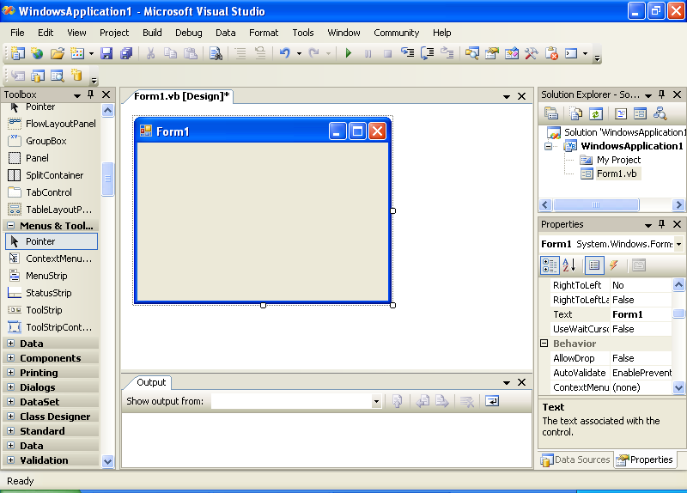
The IDE of VB.NET

Slide 10

Windows Application - provides user interface that lets the user interact with the application
Console Application – very limited user interface. Output is displayed in a command prompt.
Windows Control Library – enables building our own custom controls to be used in a Windows application.
Class Library – has no visible interface; used to add specific functionality to the project.
Windows Service – long running applications; has no visible interface. These services can be started automatically when the computer is turned on, paused, and restarted.
ASP.NET Web Application – resides on a web server and services requests made through a browser.
ASP.NET Web Service - resides on a web server and services requests but does not return any HTML page..
Web Control Library – enables building our own custom controls to be used with web pages.

Slide 11

IntelliSense is a feature of the editor that displays as much information as possible, whenever possible. The IntelliSense option includes the following sub-options:
  List Members: This option allows the editor to list all the members (properties, methods, events, and argument list) in a drop-down list
  Parameter Info: When the pointer is moved over a variable, method or property, we can see its declaration in a yellow tooltip
  Quick Info: It displays information about commands and functions. For example, when we type the opening parenthesis following the name of a function, its arguments will be displayed in a tooltip.
  Complete Word: It enables one to complete the current word by pressing Ctrl + Spacebar. For example, if we type “txt” and press Ctrl + Spacebar, we will see a list of words that match.

Slide 12

All objects in the Visual Basic language, including forms and controls, have their own
  Properties - can be thought of as an object's attributes
  Methods - can be thought of as an object's actions
  Events - can be thought of as an object's responses
Properties, methods and events constitute the programmatic interface of the control and are collectively known as the control’s members.
For example, a balloon's properties include attributes such as its diameter, and color. A balloon also has known methods or actions that it can perform. It has an inflate method (filling it with helium), a deflate method (expelling its contents), and a rise method (letting go of it). Balloons also have responses to certain external events. For example, a balloon responds to the event of being punctured by deflating, or to the event of being released by rising.

Slide 13

Name – The control’s name.
Font – To determine the size, style etc.
Enabled – To determine whether we can interact with the control or not
Size – Sets or returns the control’s size.
Text – The text that appears on the control.
Tag - Holds some extra data we want to associate with a specific control.
TabStop – Whether the control belongs to the tab order.
TabIndex – A numeric value that determines the position of the control in the Tab order.
Visible – Whether the control will be visible or not.

Slide 14

Click – Fired when a control is clicked.
Double-Click - Fired when a control is double-clicked.
Enter - Fired when a control receives the focus.
Leave - Fired when a control loses its focus.
MouseEnter - Fired when a mouse pointer enters the area of the control.
MouseLeave - Fired when a mouse pointer moves out of the area of the control.

Slide 15

Focus
  Moves the focus to the control.
Clear
  To clear the contents of a control.
Hide / Show
  To reveal or conceal the control.
Scale
  Scales the control by a value specified as argument.
  e.g. : txtName.Scale(0.75)
  This will scale the textbox control down to 75% of its current size

Slide 16


